Slide 1
Engineering STATUS Meeting
June 16h, 2025

Slide 2

What does STATUS stand for?
S - Successes
Any Ws, wins, achievements. Any progress that has been made, big or small.
T- Troubles
Current roadblocks and challenges. Anything that slows down the progress on individual or team level.
A - Actions
Actions taken to overcome the troubles.
T - Tracking
Metrics, progress reports.
U - Upcoming Priorities
Upcoming objectives for the next month
S - Support Needed
Outside help required from the product team.

Slide 3
Raheel
Upcoming Priorities from last STATUS
SEO enhancements once unblocked, landing pages once design is finalized (Mike: While some progress has been done, not to the extent that we want)
Scenarios [some minor meaningful progress]
Successes
SEO Support + SDSIcon overhaul
Visual enhancements towards Founders page
Partial completion for scenarios
Troubles
There was an issue where the viewports where different compared to the other websites
Scenarios did not have appropriate variable configuration setup in the Figma
Actions
Reached out to Mikhail and created a meeting with Mikhail and Yulia to discuss about the enhancements for scenarios and viewports

Slide 4
Ariful
Upcoming Priorities from last STATUS
Frontend side of User Notification preferences with backend sync
Setup in-app notification view logic for customers
Successes
1) Notification Settings UI
2) Auth redirection after authentication with Google & Password
3) Base SDSSwitch setup (common component that is used in Notifications)

Slide 5
Anatoly
Upcoming Priorities from last STATUS
SDS UI Components (stronger aria support, should help SEO), potentially via shadcn/ui or just Radix UI
Font Updates, once design is unblocked
Successes
SDS Components example via its own SDS package with complete unit testing setup
Stronger Typescript support and other enhancements like variable setup
Accessibility setup for SDSButton

Slide 6
Dharam
Upcoming Priorities from last STATUS
Email Handling (tied to the Notifications)
Notifications: detect if user is online, add ability to adjust the notification based on that
Successes
1) Notifications setup for Authentication (like recovery password)
2) Detection for User’s online status
3) Enhancements for the localhost’s user’s email verification + email handling

Slide 7
Mori
Upcoming Priorities from last STATUS
Get familiar with DevOps setup
Kimai installation
Appflowy installation (Mike: We onboarded Mori after the meeting + Kimai issue)
Successes
1) Kimai integration
2) Login via Google Auth in production
3) Get familiar with DevOps setup
Troubles
PHP bug was present in the public Kimai repo causing bad UX to the submitters
Actions
1) On our own end I modified the PHP file that causing the issue

Slide 8
Tracking
Tracking from last STATUS Team
We onboarded 4 new developers to our team: Ariful, Dharam, Raheel, and Mohit.
Pull Requests
26 Pull Requests have been pushed this month This Month: Team
We onboarded 2 new developers to our team: Mori and Alex
Pull Requests
17 Pull Requests have been pushed this month

Slide 9
Upcoming Priorities
Raheel
SEO enhancements once unblocked, landing pages once design is finalized
User Availability for 1-1 Coaching
Ariful
1) Fixes for recorded events
2) Carousel logic fixes Anatoly
Additional SDS Component Enhancements
Stronger TS Support
Cont. on the next slide

Slide 10
Upcoming Priorities
Alex
Resync Discount Deals information
Refactor Datetime utils
Dharam
Agnostic E-commerce logic setup (Products, Purchases and etc.)
Mohit
Refactor and fix majority of.skip() tests
Mori
Appflowy installation

Slide 11
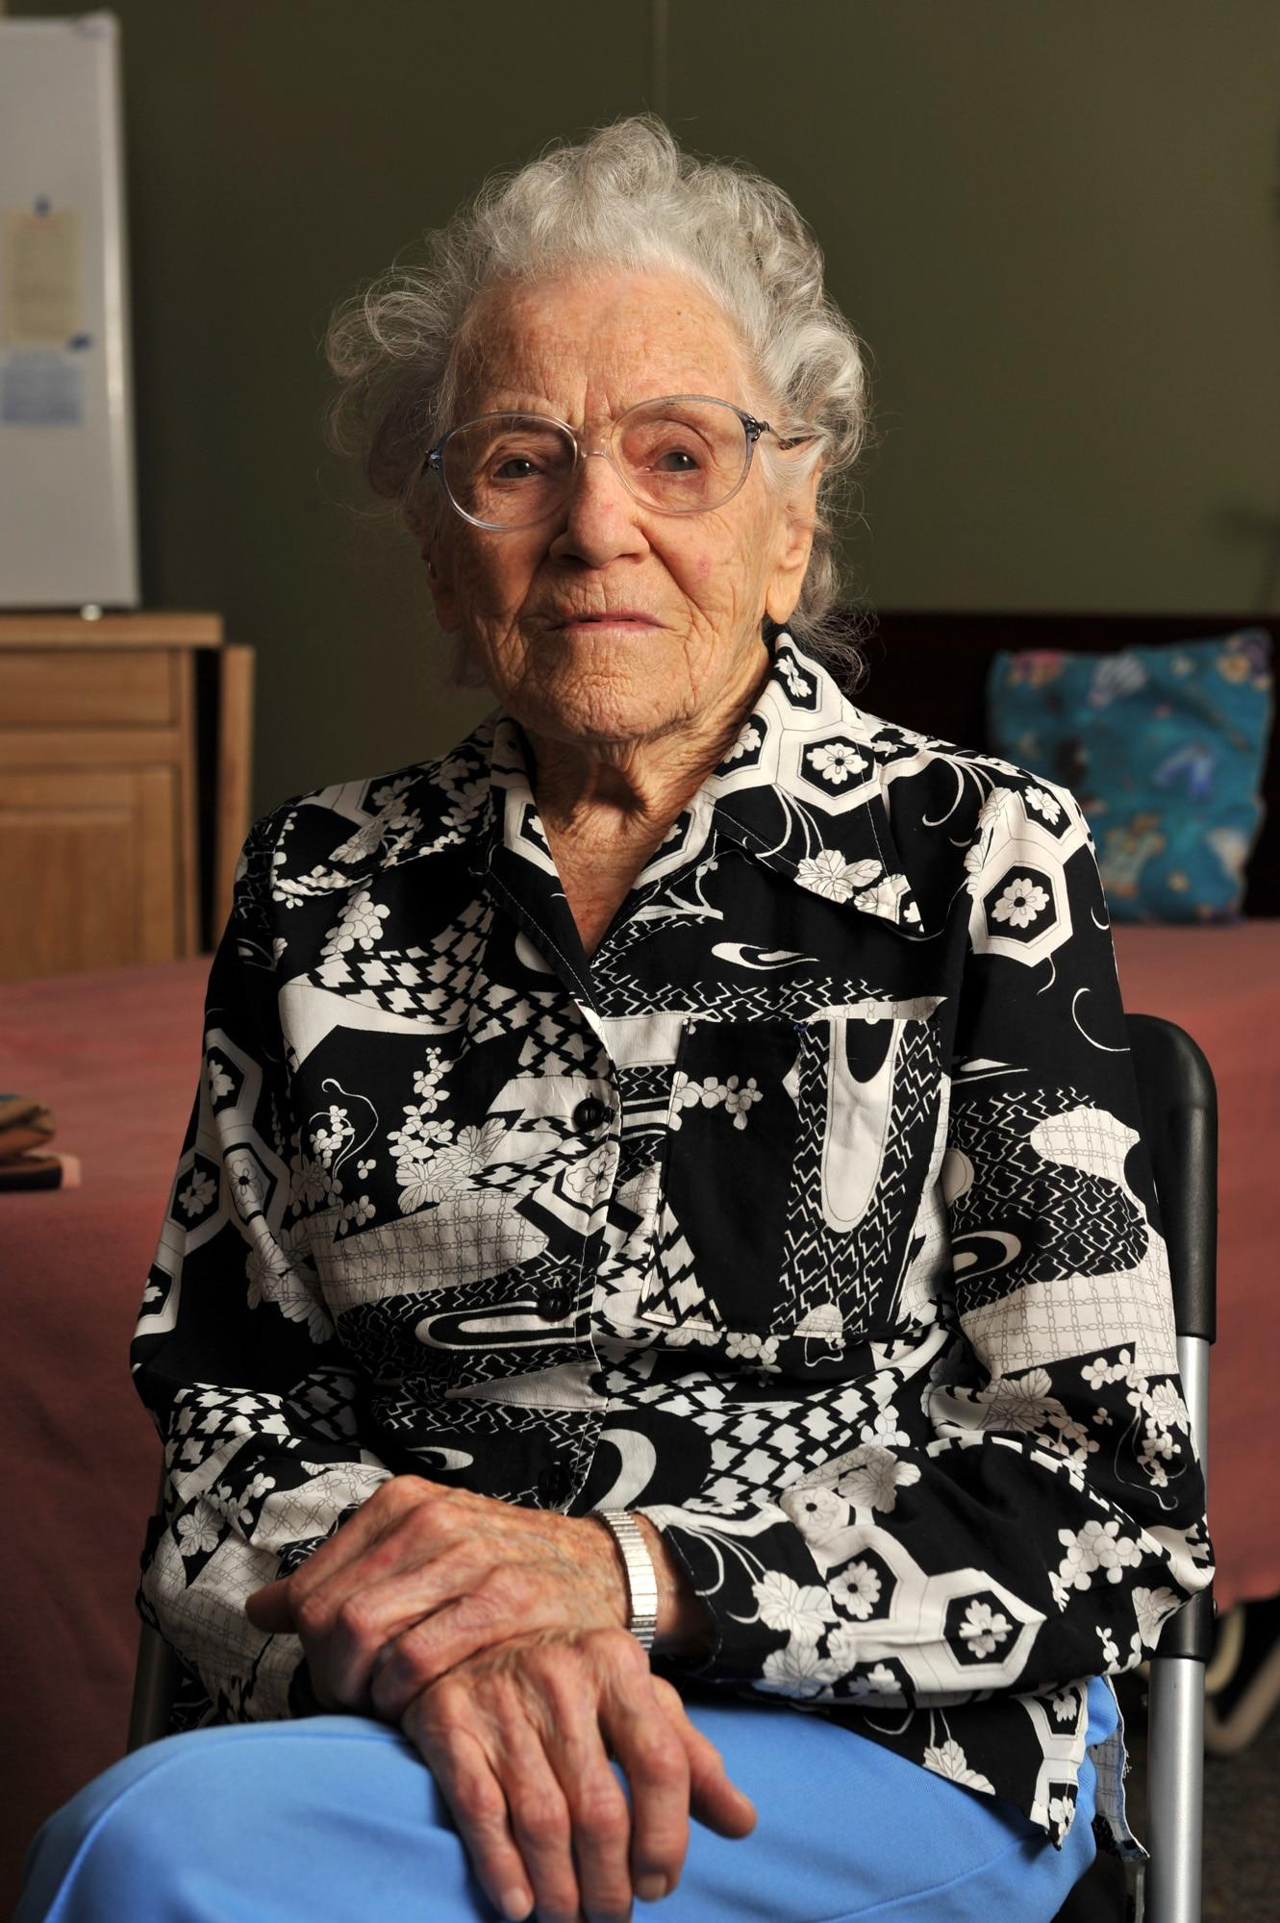
Support Needed
SEO SEO Text Content for the SEO purposes (like title and description) for all pages
Goodie … Bag ?
We don’t have images for the Goodie Bag main page
We don’t have full content for the StartHub Snacks
We don’t have descriptions for the Email Templates
Awaiting Document Templates from Graphic Design team

Slide 12
End

